Slide 1
World Wide Web
Lesson A.8

Slide 2
A) Internet Services (Software)
A.1) Client Server Model
What is a Client?
What is a Server?
A.2) Domain Names & IP Addresses
Domain Name Registry
IPv4 and IPv6
A.3) Common Internet Services
DNS (Domain Name Server)
Mail Server
Web Server
File Server
Database Server
Application Servers

Slide 3
Domain Names & IP Addresses
A.8 Day 1

Slide 4
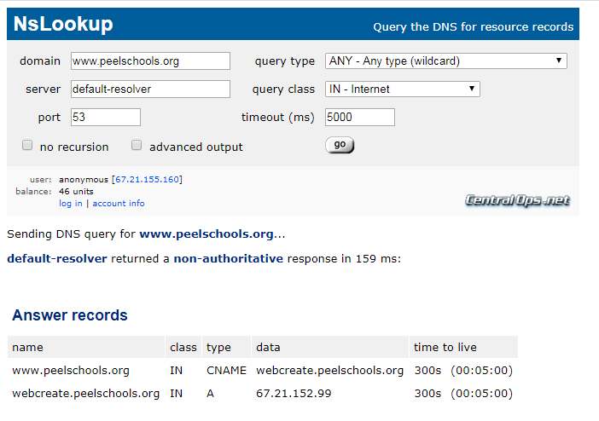
Warm-Up Activity
Goto: https://centralops.net/co/
Use the "NsLookup" Tool
www.peelschools.org
your favorite website
Try some of the other tools

Slide 5
Warm-Up Activity
https://mxtoolbox.com/DNSLookup.aspx

Slide 6

A.1) Client-Server Model
A Client Is...
An app that runs on your phone or PC
The app provides the Interface
The app does not control the data
Examples:
A Server Is...
Software that runs on hardware owned by the app company
It sends and receives data between multiple clients using internet connections
They work together to give you the complete application.
One is useless without the other part
Examples: On-Line Games, Spotify, MLB At Bat, etc.

Slide 7
A.2) Domain Names & IP Addresses
A Domain Name is...
An ID for a service on the internet
It is a human readable format
It must be converted to an IP address to be used by a computer
Note: Clients do not have Domain Names
An IP Address is...
The id number of a client or server device on the internet.
It is composed of four numbers
It is used to route messages and data between computers (clients and servers)
Domain Example:
www.peelschools.org
IP Address Example:
67.21.152.99
Note: IP stands for Internet Protocol

Slide 8


A.2) Domain Names & IP Addresses
Who owns names and addresses?
Domain names can be registered by companies and individuals
Government Agencies Control the Registration of Names
myname.ca – CIRA (Canada)
myname.uk – NOMINET (United Kingdom)
com, org, etc. – Network Solutions (United States)
IP Addresses are owned by large Internet Companies
IP Addresses are "rented out" to Domain Names for a fee
With IPv4 there are a limited number of IP Addresses
Domain Name Registry
Companies like GoDaddy.com are middlemen that arrange domain registrations and that provide you with an IP Address
Network Solutions is the company that controls and authorizes registrations for .com domains

Slide 9
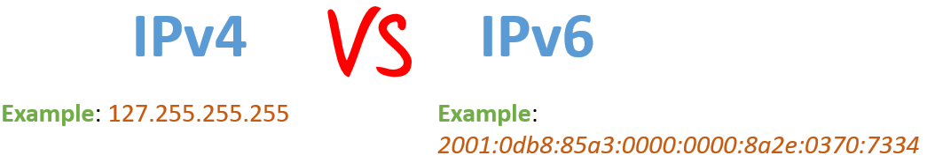
A.2) Domain Names & IP Addresses
IPv4 (1990 to Present)
4 numbers, 64 bits (2^64 combinations)
Issues: Limited Speed & Limited Number of Connections
IPv6 (Near Future)
8 alpha –numerics, 128 bits (2^128 combinations)
Advantages: Higher Speed & Unlimited Number of Connections
5G Networks (Coming Soon)
Leverages IPv6 technology to provide extreme speeds
Every device (e.g. doorbell) will have its own IP address

Slide 10
Web Server Software
A.8 Day 2

Slide 11

Warm-Up Activity
Creating a simple Web Page
Use the search button (magnifying glass icon) in the bottom windows tray
Find and open the “notepad” text editor application.
Use “Save As…” to go to your student folder (G drive) save the file as “mywebpage.txt”
Edit and save the file with the suggested contents

Slide 12
Warm-Up Activity
Opening your web page
Open your web browser (e.g. Chrome)
Type “file://G:/” for the URL. What do you see?
Click on your “mywebpage.txt” to open it. What do you see?
Use File Explorer to rename your file to “mywebpage.html”
Refresh the “file://G:/” URL
Click on your “mywebpage.html” to open it. What do you see?

Slide 13
What Is A Web Page?
A Web Page is written in HTML
HTML stands for Hyper-Text Markup Language
It is simple text with special tags in angle <> brackets
Most tags control how the page is formatted
Additional tags allow for graphics and dynamic content
A Basic Web Page
Contains static content (i.e. text content that does not change when the page is reloaded.)
The page can contain advanced graphics in addition to text.
Dynamic Web Pages
Are basic web pages that also include dynamic content that may change while the page is loaded or when it is reloaded.
May also include program scripts using JSP, Java, Python, etc.
Dynamic pages include links to include data from other types of web servers (e.g. Streaming Servers, Database Servers, etc.)

Slide 14
What Is A Web Server?
A Web Server is an Application Program
You could run this program on any PC
Usually runs on more reliable Web Server Hardware
Most common web server programs include:
Apache – Unix / Linux
IIS – Microsoft
The function of a Web Server is…
To respond to HTTP or HTTPS internet requests from user clients (i.e. web browsers)
To provide service for basic web pages
Web Servers communicate with other internet servers…
To verify account information and user access
To provide dynamic content

Slide 15
What is HTTP and HTTPS
Starting a URL with http:// indicates that..
HTTP stands for Hyper-Text Transfer Protocol
Your browser (client) wants to connect to a web server
Your browser is expecting to receive HTML content
Starting a URL with https:// indicates that..
The same thing as http with the addition that…
Information sent and received is in encrypted format
https provides a basic level of security for passwords and other private information
Other URL protocols include…
file:// to access files on a local computer
ftp:// to access files or a remote serer
telnet:// to open a window on a remote serer

Slide 16
E-Mail Server Software
A.8 Day 3

Slide 17
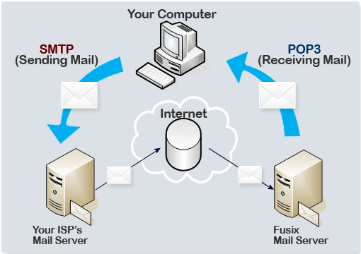
E-Mail Server Software
SMTP Protocol
Allows your PC to send mail
IMAP (POP3) Protocol
Allows your PC to read mail
Web Mail
All mail stays on the server
Server provides a dynamic web site that you access through a web browser

Slide 18
Venn Diagram
SMTP
IMAP & POP3
Web Mail

Slide 19
Venn Diagram
SMTP
IMAP & POP3
Facts Common Between SMTP
and Web Mail
Facts Specific to Web Mail
Use bullet point notes
Web Mail

Slide 20
Local Area Network (LAN)
A.8 Day 4

Slide 21
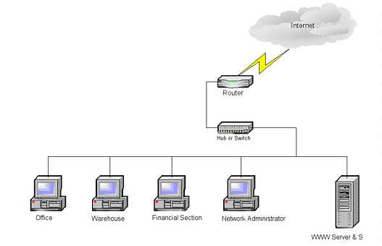
What is a LAN?
LAN stands for Local Area Network
A LAN is a small group of related computer equipment.
In your house
In a business office
In a classroom
Equipment connected to a LAN includes
PCs, Laptops, Smartphones, and other personal computers
Printers, TVs, Security Cameras, Alexa, and other devices
Switch & Router (sometimes called a Hub)

Slide 22
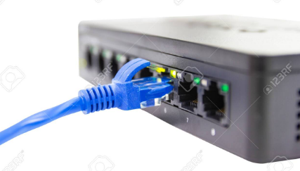
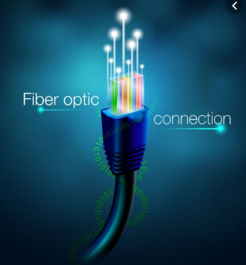
LAN Connection Technologies
Devices can connect to a LAN Hub using…
Ethernet Cables (e.g. blue wires) – High Bandwidth
WiFi – Medium Bandwidth but Most Convenient
Hotspot – Medium Bandwidth for Special Cases
USB Printer Cable – Low Bandwidth
The LAN Hub can connect to the internet using…
Fiber Optic (e.g. Fibe) – Extreme Bandwidth
WiFi - Medium Bandwidth
Cable TV – High Bandwidth
DSL Phone Lines – Medium Bandwidth
Dialup Modem – Very Slow and Old Technology
Satellite – Special Cases

Slide 23
Internet Hosting
A.8 Day 5

Slide 24


Hosting Service Providers
GoDaddy Curse
https://dailyhive.com/toronto/godaddy-curse-raptors-cj-miles
Hosting Service Providers allow you to set up a presence on the Internet
For business reasons
For personal interest
Note: These providers do not provide Internet Connection Services.

Slide 25




Internet Service Providers (ISPs)
An Internet Service Provider (ISP)
provides hardware and software services
to connect your LAN to the Internet.
Both home and business
Two most popular ISPs in Ontario are Bell and Rogers, but there are other choices.

Slide 26
Blank Slide

Slide 27
Extra Stuff
A.8 Day X

Slide 28
A.3) Common Internet Services
DNS (Domain Name Server)
Web Server
HTTP protocol
Mail Server
File Server
Database Server
Application Servers

Slide 29
A.3) Common Internet Services
DNS (Domain Name Server)
Web Server
HTTP protocol
Mail Server
File Server
Database Server
Application Servers

Slide 30
B) Internet Servers (Hardware)
Firewall, Lan, Wan
VPN
RAID

Slide 31
